Slide 1

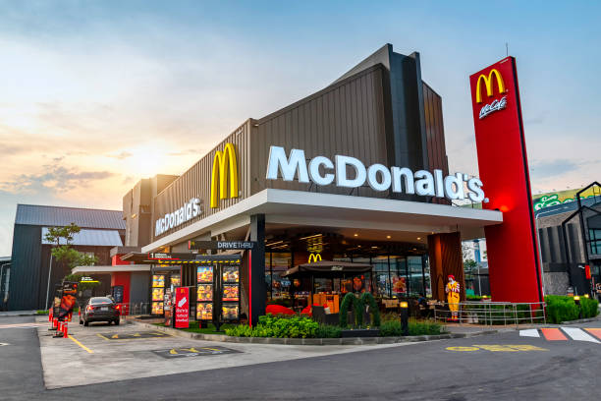
The Main objective of
this project is to analyze
Sales data to gain
actionable insights that
Will enhance the
performance of the
McDonald’s shop.

Slide 2

Recommended Analysis
1. Key Performance Indicators :-
1. Total sales in the year 2022.
2. Total profit in the year 2022.
3. Amount of Customers.
2. What is the total sales revenue for each month ?
3. How do sales vary across different country ?
4. What is the Customer Satisfaction Rate ?

Slide 3
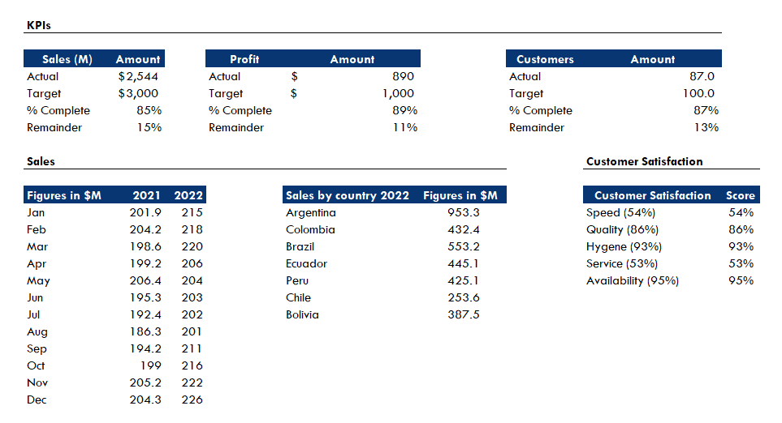
Inputs

Slide 4
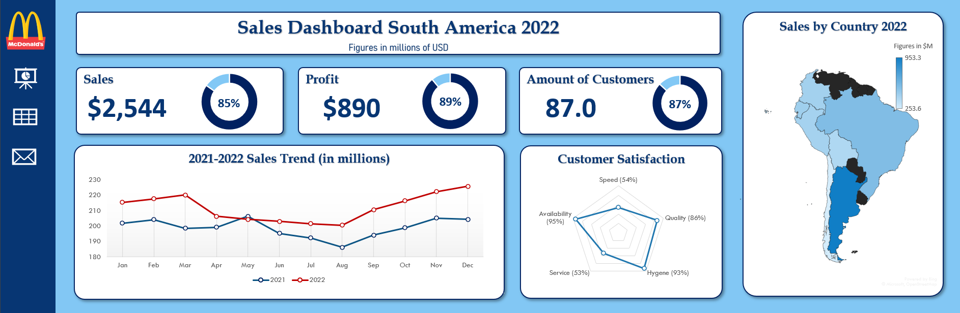
Dashboard

Slide 5
THANK YOU

